Slide 1

CISC 250 – Business Telecomm Networks
Network Layer Protocols
- Internet Protocol (IP)

Slide 2
Network layer
moving data across a series of interconnected networks
on sending side encapsulates segments into packets (or datagrams)
on receiving side, unwraps packets and delivers segments to transport layer
network layer protocols in every host, router
Router examines header fields in all IP datagrams passing through it
application
transport
network
data link
physical
network
data link
physical
network
data link
physical
network
data link
physical
network
data link
physical
network
data link
physical
network
data link
physical
network
data link
physical
network
data link
physical
application
transport
network
data link
physical

Slide 3
Two Key Network-Layer Functions
routing algorithm
routing: determine route taken by packets from source to destination.
routing algorithms
local forwarding table
header value
output link
0100
0101
0111
1001
3
2
2
1
value in arriving
packet’s header
0111
1
3
2
forwarding: move packets from router’s input to appropriate router output

Slide 4
The Internet Network layer
Transport layer: TCP, UDP
Routing protocols
path selection
RIP, OSPF, BGP
IP protocol
addressing conventions
datagram format
packet handling conventions
Network
layer
forwarding
table
ICMP protocol
error reporting
router “signaling”
Link layer
physical layer
The Internet Protocol
Packets, addressing and routing
Two types: IPv4 and IPv6

Slide 5
Basic History of IP
IP – Internet Protocol
Defined in RFC 791, dated 1981, written by Information Sciences Institute @ USC
Written for DARPA (Defense Advanced Research Projects Agency)

Slide 6
Versions of IP
IPv0 – 3: Experimental Only
IPv4: Defined in 1981 by RFC 760 & 791. First version to implemented publically. Still in use today.
IPv5: Also experimental, called Internet Stream Protocol.
IPv6: Also called IP Next Generation (IPng), Defined in 1998 by RFC 2460-2467

Slide 7






IPv4 Exhaustion
IANA doles out IPv4 blocks to the regional providers
Notes:
IANA gives out blocks to the regionals.
IANA ran out of IPv4 blocks in early 2011.
The regionals are not out of assignable IPv4 blocks, but will be “soon”.
Update: ARIN is already out of /8 blocks
https://en.wikipedia.org/wiki/IPv4_address_exhaustion
We're not actually out of IPv4 addresses. We're out of assignable IPv4 address blocks.

Slide 8
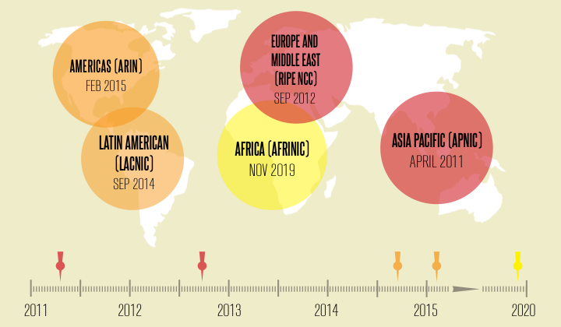
IPv4 Exhaustion
Notes:
http://www.worldipv6launch.org/infographic/

Slide 9
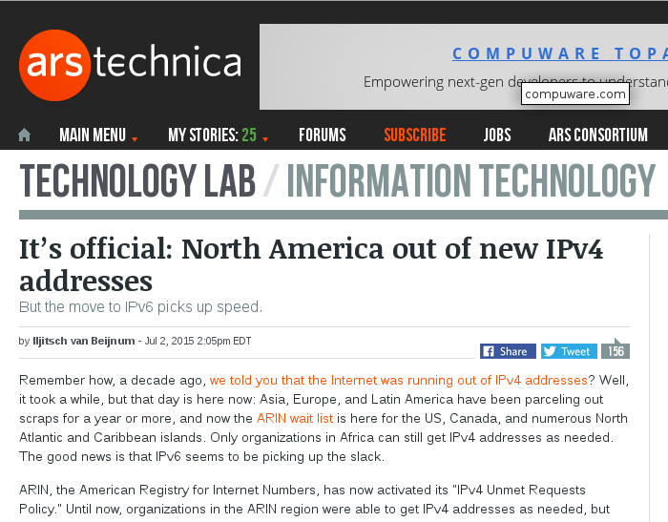
IPv4 Exhaustion
Notes:
http://arstechnica.com/information-technology/2015/07/us-exhausts-new-ipv4-addresses-waitlist-begins/
Remember: we're not out of IP (v4) addresses, we're out of assignable blocks.

Slide 10
IPv4 Packet vs. IPv6 Packet
0
15
16
31
Removed (6)
vers hlen TOS total length
identification flags flag-offset
ID, flags, flag offset
TOS, hlen
header checksum
20
bytes
TTL protocol header checksum
source address
destination address
Changed (3)
options and padding
total length => payload
protocol => next header
TTL => hop limit
IPv4
vers traffic class flow-label
Added (2)
payload length next header hop limit
traffic class
flow label
40
bytes
source address
Expanded
destination address
address 32 to 128 bits
IPv6

Slide 11
Major Improvements of IPv6 Header
No option field: Replaced by extension header. Result in a fixed length, 40-byte IP header.
No header checksum: Result in fast processing.
No fragmentation at intermediate nodes: Result in fast IP forwarding.
IPv6-Google

Slide 12
IP Addresses: IPv4 vs IPv6
IPv4 | IPv6
Deployed 1981 | Deployed 1999
32-bit address 192.149.252.76 | 128-bit address 2001:DB8:0234:AB00:0123:4567:8901:ABCD
Address space 2³² = ~4,000,000,000 | Address space 2¹²⁸ = ~340,000,000, 000,000,000,000,000, 000,000,000,000,000
Security, autoconfig, QoS, mobility added later (IPSec etc) | Security, autoconfig, QoS (quality of service) “built-in”
Projected lifetime: 2012 | Projected lifetime: Indefinite
Notes:
12

Slide 13
Transition From IPv4 To IPv6
Not all routers can be upgraded simultaneous
no “flag days”
How will the network operate with mixed IPv4 and IPv6 routers?
Tunneling: IPv6 carried as payload in IPv4 datagram among IPv4 routers
Dual Stack: IPv6 and IPv4 running simultaneously.

Slide 14
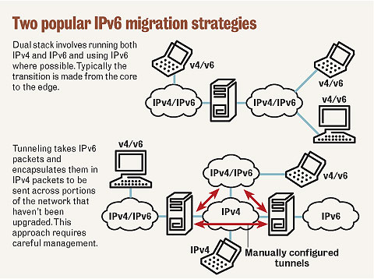

Slide 15
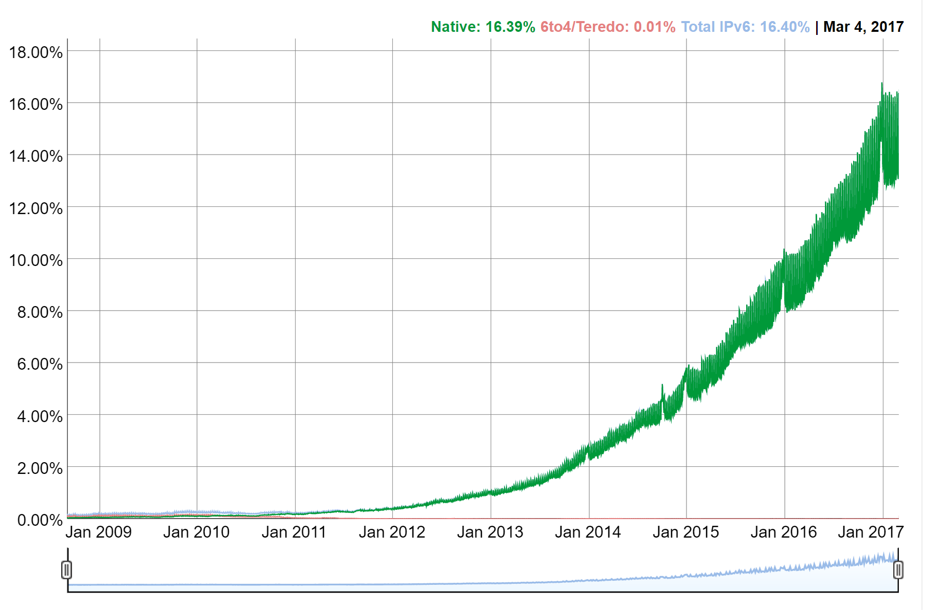
IPv6 Adoption

Slide 16
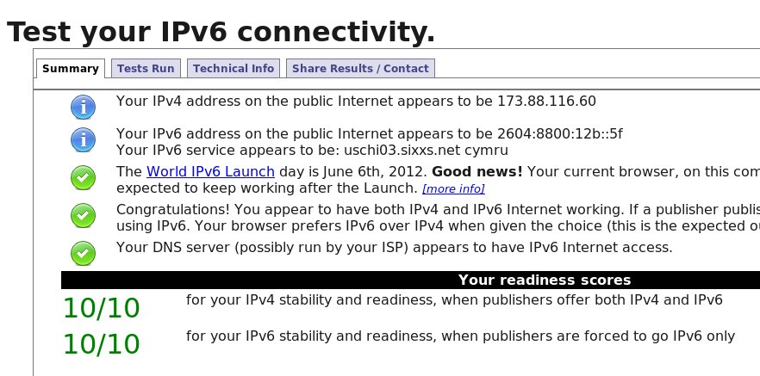
http://test-ipv6.com/
Notes:
The current ISP for the home system is Time-Warner Cable / RoadRunner.
The current service is IPv4 only.
IPv6 connectivity for home systems is via dedicated tunnel to a /48 IPv6 segment.
Specifically, a Xen guest of SLE 10 runs 'aiccu' with SixXS (TIC) and carries all IPv6 traffic for the home network.

Slide 17
IPv4 Addressing: introduction
IP address: 32-bit identifier for host, router interface
interface: connection between host/router and physical link
routers typically have multiple interfaces
host typically has one interface
IP addresses associated with each interface
223.1.1.1
223.1.2.1
223.1.1.2
223.1.1.4
223.1.2.9
223.1.2.2
223.1.1.3
223.1.3.27
223.1.3.1
223.1.3.2
223.1.1.1 = 11011111 00000001 00000001 00000001
223
1
1
1

Slide 18
IP addresses: how to get one?
Hard-coded by system admin in a file
Wintel: control-panel->network->configuration->tcp/ip->properties
UNIX: /etc/rc.config
DHCP: Dynamic Host Configuration Protocol: dynamically get address from a server
“plug-and-play”
Command line utility: ipconfig

Slide 19
IP Address Structure
Network Part (not always 16 bits)
Host Part (not always 16 bits)
128.175.17.13
The Internet
UD Network
(Network ID: 128.175.0.0)
128.175.17.13
(Host ID: 0.0.17.13)

Slide 20
Division b/w Network ID & Host ID
Unique address
Network ID assigned globally – Internet Assigned Number Authority (IANA)
Host ID assigned locally
How many bits for Network and for Host?
Where is that “dividing line”?
Types of addressing
“Classful”
Divide on octect boundaries
Subnetted “Classful”
Use a subnet mask
Classless
Indicated by the prefix length

Slide 21
IP Address
32 binary numbers (bits)
dotted decimal notation (xxx.xxx.xxx.xxx)
Each decimal number represents eight bits (one octet) of binary data
0 ~ 255
E.g. 128.196.205.27 to Binary
10000000 11000100 11001101 00011011

Slide 22
Decimal to Binary
Decimal | 128 | 64 | 32 | 16 | 8 | 4 | 2 | 1 | Binary
128 | 1 | 0 | 0 | 0 | 0 | 0 | 0 | 0 | 128 = 128 10000000
196 | 1 | 1 | 0 | 0 | 0 | 1 | 0 | 0 | 196 = 128+64+4 11000100
205
27
http://www.youtube.com/watch?v=qWxiXU02ZQM

Slide 23
Binary to Decimal
Binary | 128 | 64 | 32 | 16 | 8 | 4 | 2 | 1 | Decimal
11001100 | 1 | 1 | 0 | 0 | 1 | 1 | 0 | 0 | 128+64+8+4 = 204
10101010 | 1 | 0 | 1 | 0 | 1 | 0 | 1 | 0
11100011 | 1 | 1 | 1 | 0 | 0 | 0 | 1 | 1 | 128+64+32+2+1 = 227
10110011 | 1 | 0 | 1 | 1 | 0 | 0 | 1 | 1 | 128+32+16+2+1 = 179
http://www.youtube.com/watch?v=UUqtjb8WEUs

Slide 24
IP Address Classes
Originally (before 1993), IP had address classes with fixed numbers of bits in the network part
Class A: 8 bits (24 bits in host part)
Class B: 16 bits (16 bits in host part)
Class C: 24 bits (8 bits in host part)
Self-encoded:
The router looks at the first few bits of the IP address, and then will be able to decide where to draw the line

Slide 25
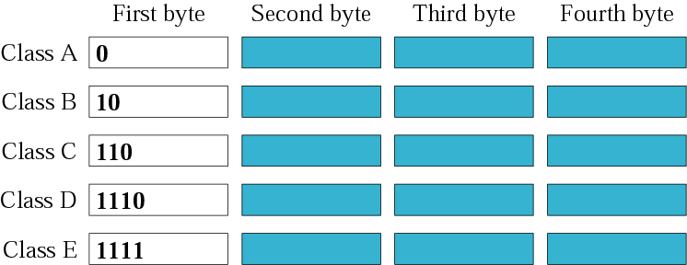
IP Address Classes
How can we recognize to which class an IP address belongs to?
Look at the first 4 bits!

Slide 26
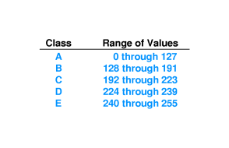
IP Address Classes
Another way to determine the address class is by looking at the first number in the dotted decimal notation

Slide 27
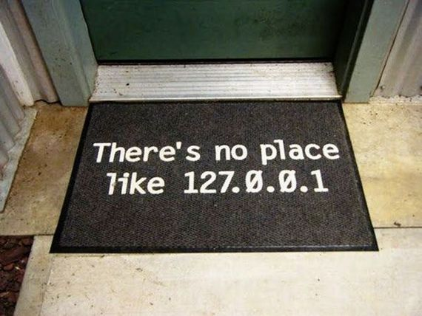
Special IP Addresses
Loopback addresses
used for testing
information sent internally to the TCP/IP stack
127.x.x.x (e.g. 127.0.0.1)
Private networks
10.0.0.0 – 10.255.255.255 (Full Class A)
172.16.0.0 – 172.31.255.255 (16 Class B’s)
192.168.0.0 – 192.168.255.255 (Full Class B)

Slide 28
Network Address Translation
Each organization- single IP address
Within organization – each host with IP unique to the organization, from reserved set of IP addresses
3 Reserved ranges
10.0.0.0 – 10.255.255.255 (16,777,216 hosts)
172.16.0.0 – 172.31.255.255/12 (1,048,576 hosts)
192.168.0.0 – 192.168.255.255/16 (65,536 hosts)

Slide 29
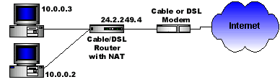
NAT Example
10.0.0.4
C
B
10.0.0.1
Source Computer | Source Computer's IP Address | Source Computer's Port | NAT Router's IP Address | NAT Router's Assigned Port Number
A | 10.0.0.1 | 400 | 24.2.249.4 | 1
B | 10.0.0.2 | 50 | 24.2.249.4 | 2
C | 10.0.0.3 | 3750 | 24.2.249.4 | 3
D | 10.0.0.4 | 206 | 24.2.249.4 | 4

Slide 30


